Slide 1

Facial Expression Recognition (FER)
Adrian Gheorghiu
Nazanin Niayesh

Slide 2
Outline
Introduction
Proposed solution
Dataset
Experiments
Results
Conclusion and Future Works

Slide 3
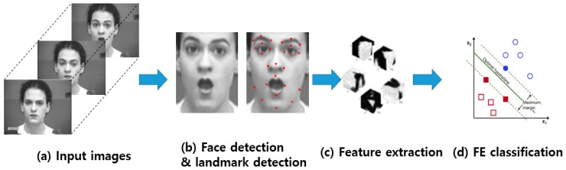

Facial Expression Recognition (FER) - Introduction
Automate recognition of human facial expressions
E.g. using deep learning
Application areas: education, healthcare, personalized services

Slide 4

Proposed Solution
Perform EDA on the dataset and augment using StarGAN
Fine tune pre-trained classifier models
Train on dataset for accurate and efficient real-time FER
Develop mobile Android app
Improve user experience and app reliability with OOD detection and Uncertainty Estimation
Challenges: imbalanced dataset, appropriate model size, user-friendly interface, real-time detection functionality
Notes:
EDA: Exploratory data analysis → analyzing data sets to summarize their main characteristics (basically looking at dataset and noticing e.g. disgusted imbalance)
Uncertainty estimation: dropout function on app: to improve model performance by factoring several different predictions

Slide 5
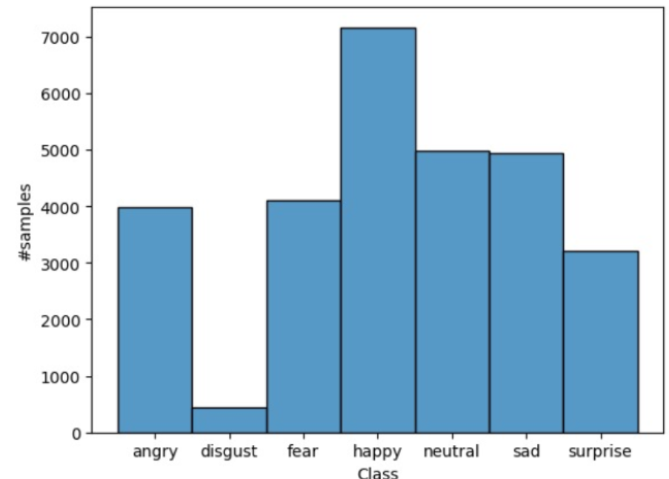







“Face Expression Recognition 2013” Kaggle Dataset
Angry, disgusted, fearful, happy, sad, neutral, surprised
~36k of images/data
Various ethnicities, sex, ages, lighting,
angles, etc.
Imbalanced regarding “disgusted”
Angry Disgusted Fear Happy Neutral Sad Surprised

Slide 6

Experiments
Balancing dataset by generating synthetic “disgusted” data
Models: ViTtiny, ViTsmall, CoaT-Lite tiny, MobileNet v2
Online augmentation functions:
Cutout
Cutmix
Fmix
Mixup
OOD Detection using Mahalanobis Distance
Uncertainty Estimation using Monte Carlo dropout
Notes:
Cutout: an image augmentation strategy that randomly masks out square regions of input during training (object occlusion).
Cutmix: instead of simply removing pixels from the image like cutout, the removed regions are replaced with patches from another image.
Fmix: similar to cutmix but uses masks sampled from fourier space to mix 2 training samples.
Mixup: linearly combines 2 training samples by creating a weighted combination of them. The result of these combinations are shown and discussed in the following “Results” section.

Slide 7
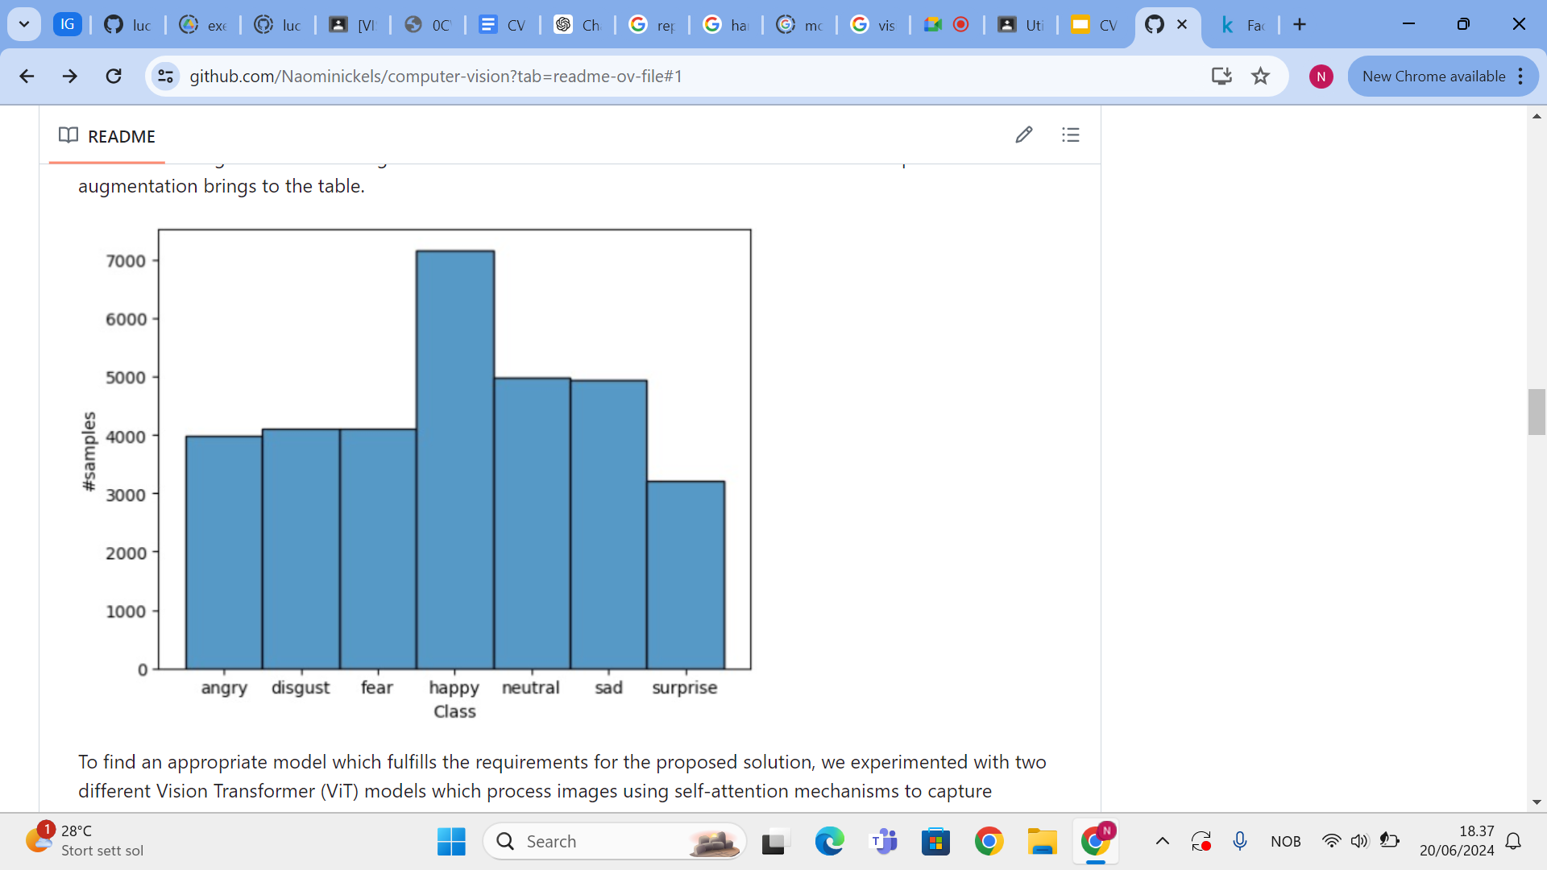
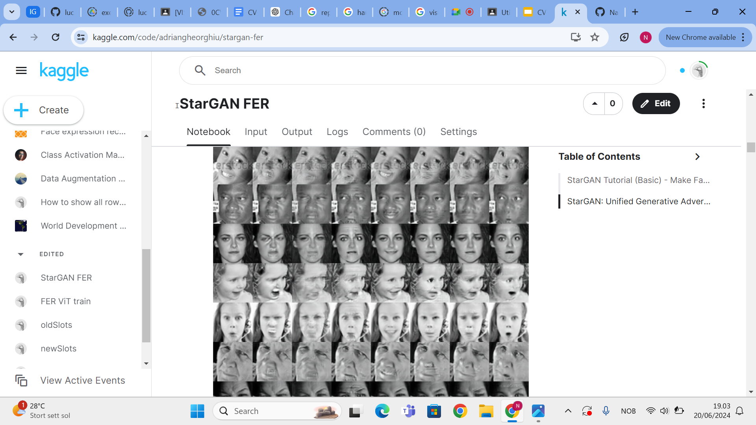
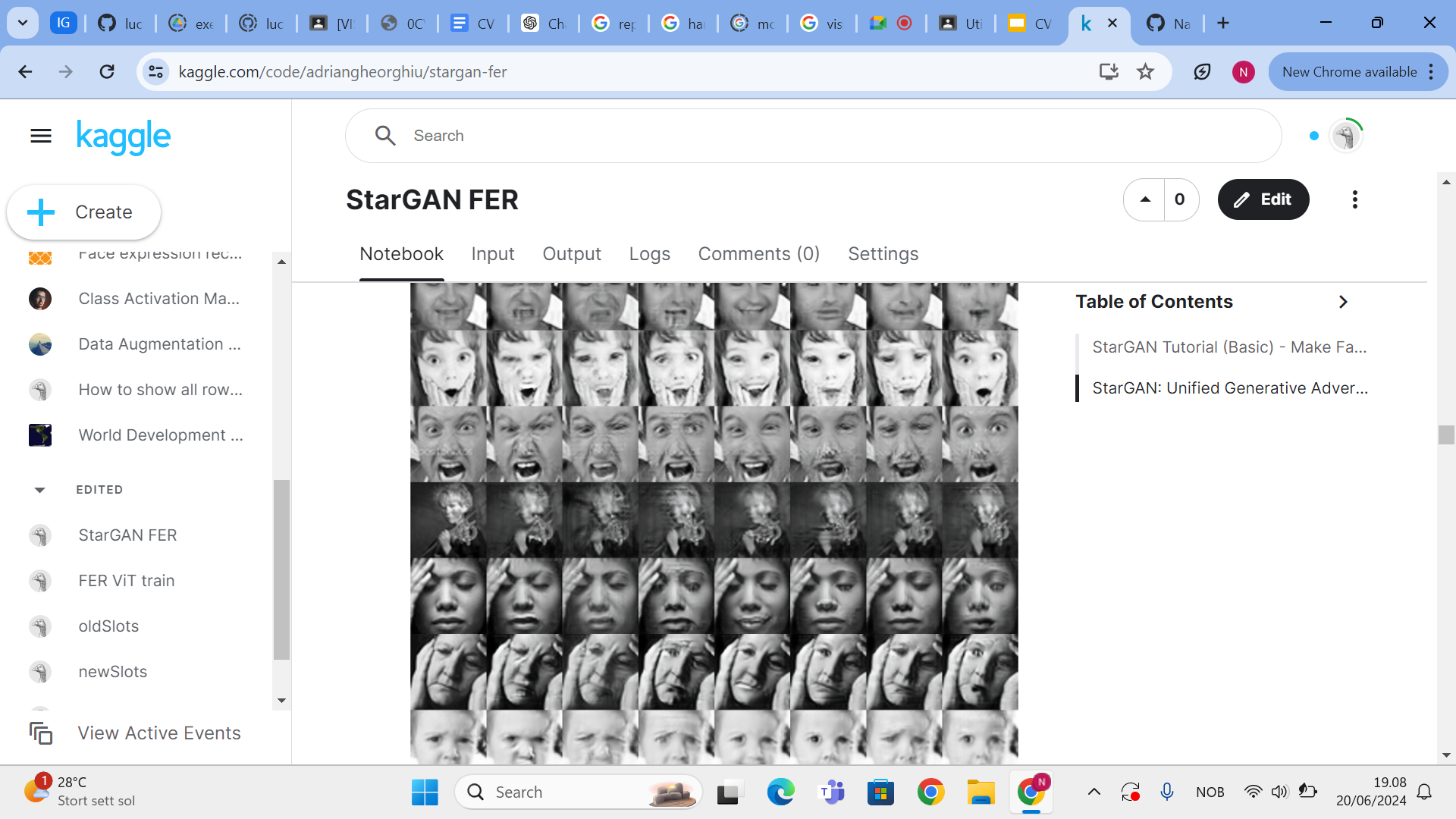
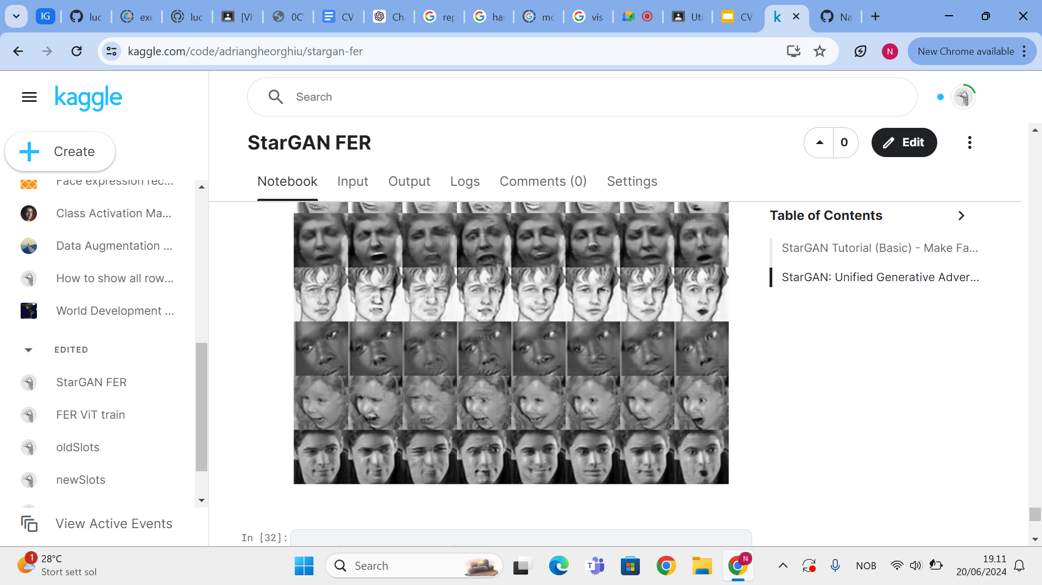
Augmenting/balancing dataset
StarGan generative adversarial network
Other images translated to “disgusted”
Original Angry Disgusted Fear Happy Neutral Sad Surprised
Notes:
Stargan works by learning mappings between every combination of styles, and is more efficient, therefore being perfect for the task at hand.

Slide 8
Evaluation metrics
Accuracy
Macro Precision (average of all 7 classes)
Macro Recall (average of all 7 classes)
Macro F1 (average of all 7 classes)
Notes:
As also mentioned in the lectures, the evaluation metrics we used are…
Accuracy: Correct predictions over whole predicted sample
Precision: the ratio of correct predictions over the whole correct samples
Macro Precision: Sum of precision score of all 7 classes divided by 7 to get average
Recall: ratio of correct predictions for a class to the total number of cases in which it occurs
Macro recall: again averaged over 7 classes
F1 score: harmonic mean between precision and recall
2*( (precision*recall)/(precision+recall)

Slide 9
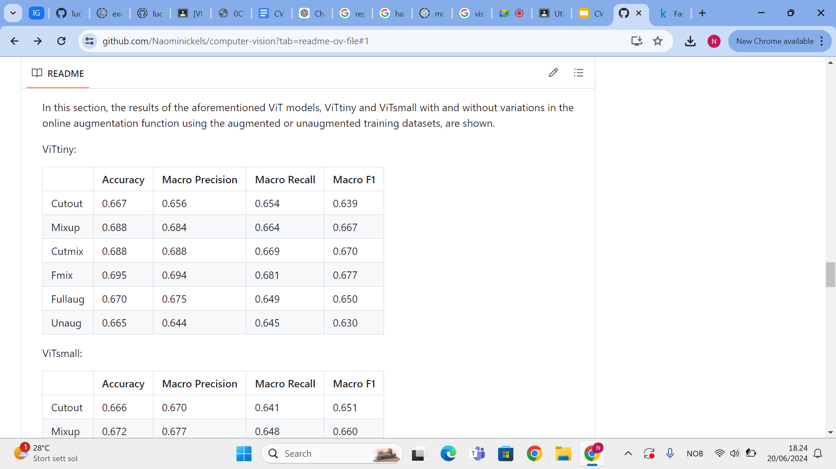
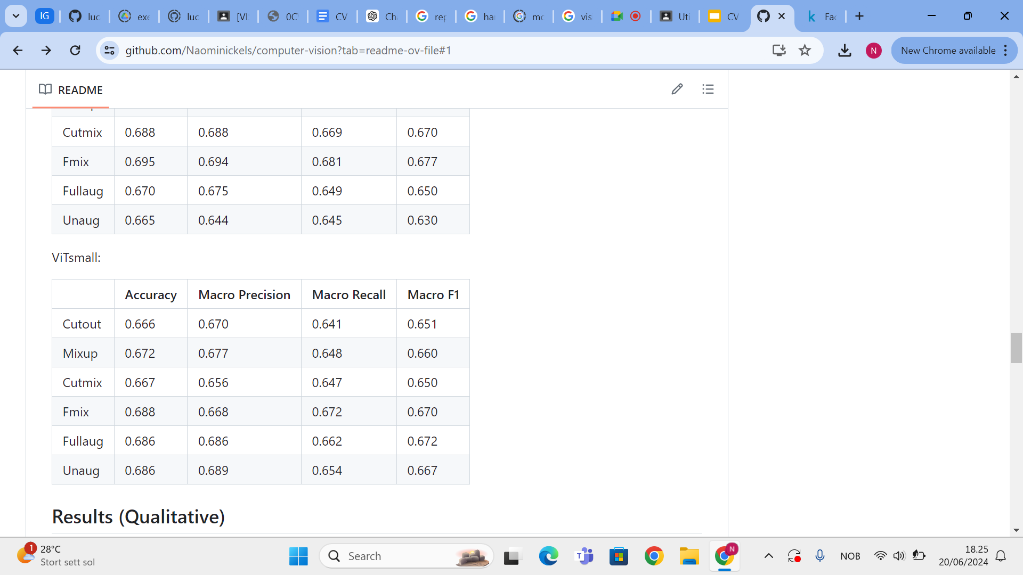
Results - Metrics
ViTtiny
ViTsmall
F1 disgust unaug: 0.568 aug: 0.703 unaug: 0.670 aug: 0.673
Notes:
FMix has better performance across the board for both models apart from a couple of cases. We can notice how using the synthetic augmentations improves performance in both cases, with the change being most visible when we isolate F1 score for disgust

Slide 10
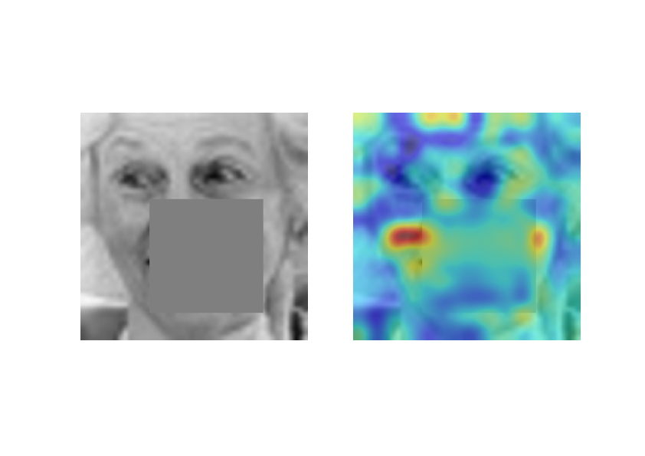
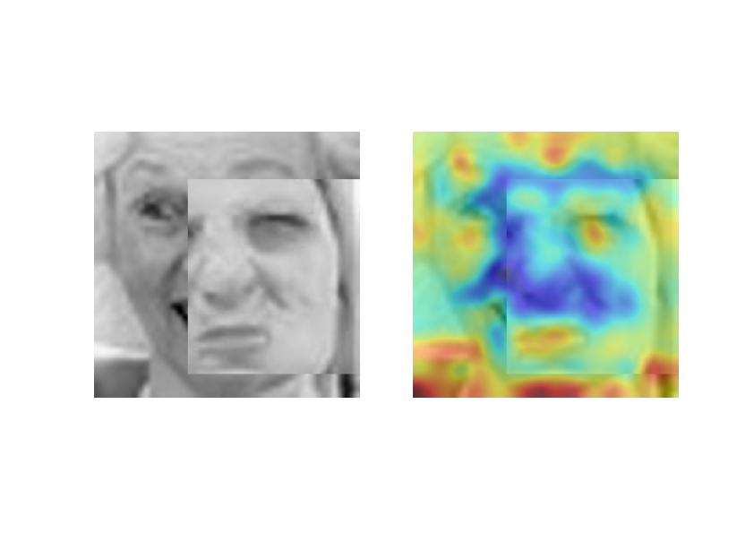
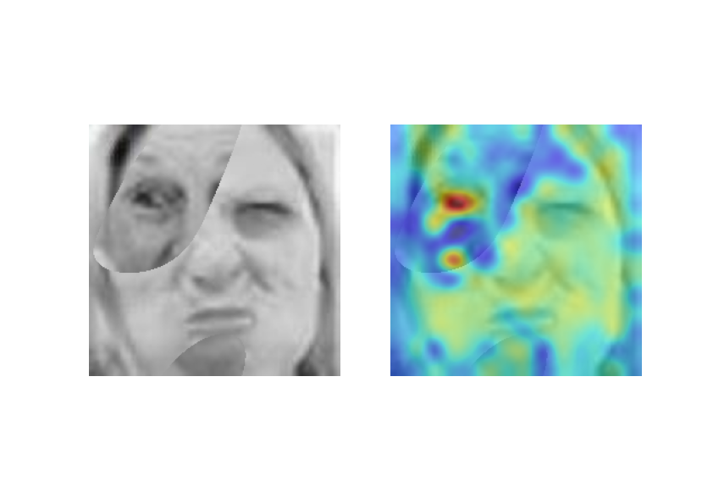
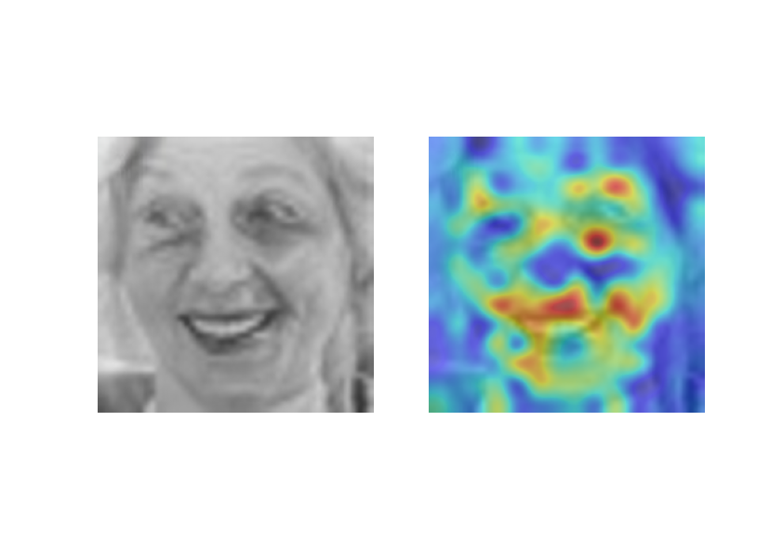
Results - Class Activation Maps (CAM)
Cutout
Cutmix
Fmix
Mixup

Slide 11
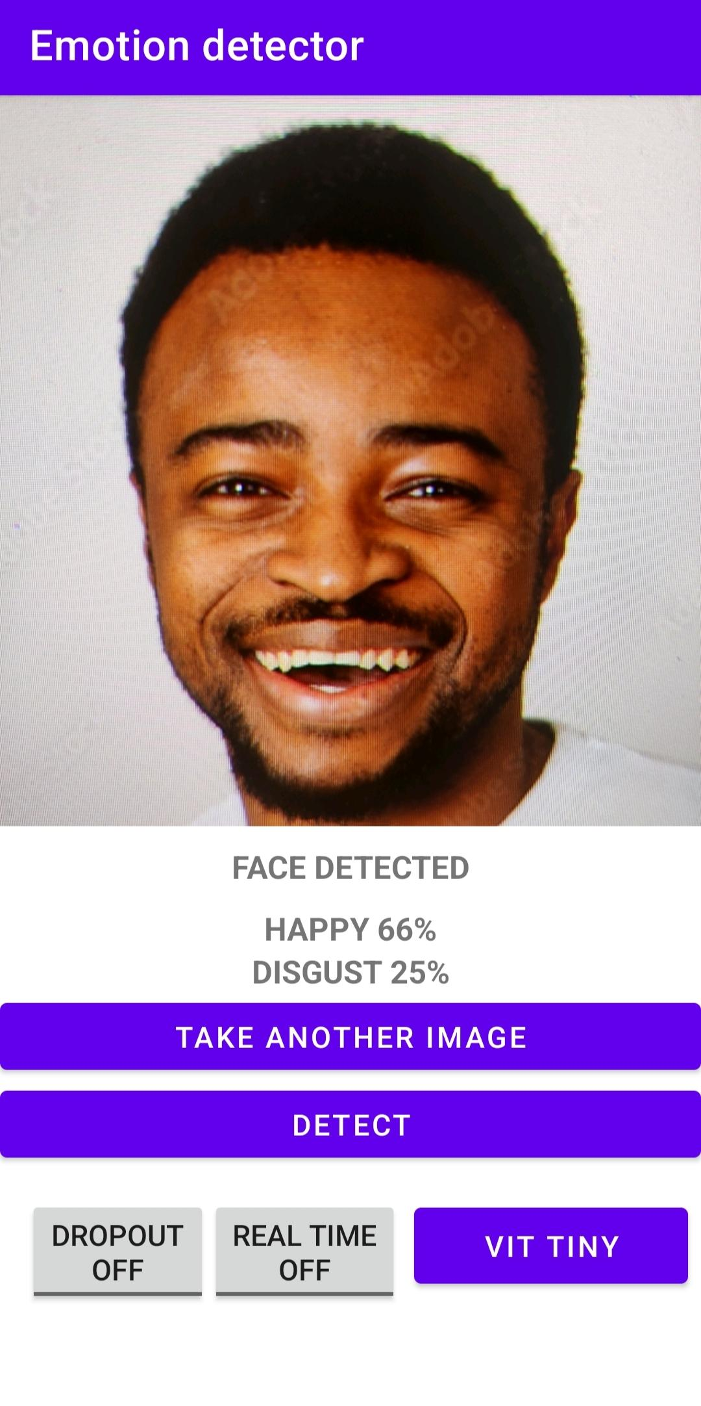
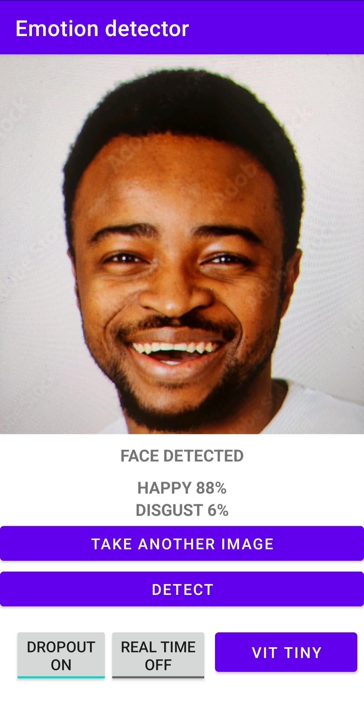
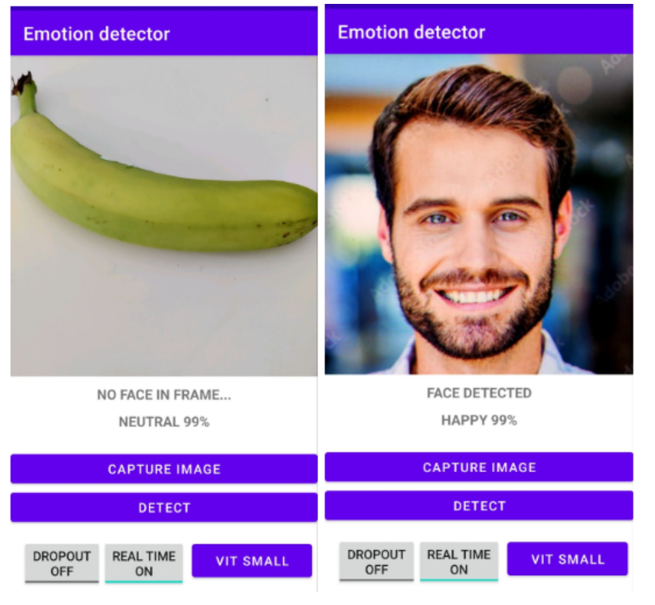
Results - Mobile App
Notes:
These areTurning dropout function on improves uncertainty estimation through doing multiple passes with the dropout layers left on and then averaging the prediction confidences. This steers the confidences towards the actual distribution.

Slide 12
Conclusion
Best performance overall on testset: ViTtiny with Fmix
Best performance of ViTsmall on testset: with Fmix
In the app, ViT-small seems to be more precise
Improved performance of both models using augmented dataset compared to unaugmented
OOD and Uncertainty Estimation improve usability of app
Notes:
Best performance = highest accuracy and F1 score
Fmix aug func works best for this task: An explanation for this may be that this way the model learns to focus on what actually makes a face have a certain emotion and helps it not overfit on specific traits, while at the same time providing a more natural and better spectrally responsive way of mixing the two images.

Slide 13
Future Work
Experiment with other models, like Swin Transformer or even Contrastive Captioners.
Possible to adjust other classes of the dataset with synthetic data too.
Try other online augmentation techniques, e.g. color-space augmentation methods.
Implement StarGAN into app for real-time emotion style transfer.
Notes:
color-space-augmentation methods (adjusting brightness, contrast, saturation, etc.)

Slide 14
Thanks for your attention!

